Slide 1
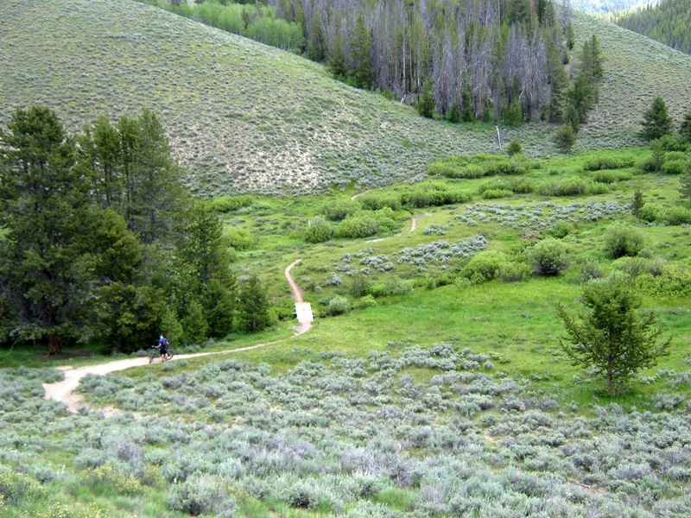
Fisher Creek trail, Idaho
Image used with permission from kanyonkris.blogspot.com
Notes:
Fisher Creek Trail, Sun Valley Idaho
Examples of differing soil, elevation and drainage create varied habitat from the creek upwards (sage grows were water drains quickly. Shrubs grow where water is plentiful in valley and grass grows where there is water and good soil. Lodgepole pine in top center grow only on the North facin slopes where there is less direct light and they can conserve water. Other pines on left grow in low, relatively wetter areas. Aspen (orange) grow on margins of pines with plenty of light and open space.

Slide 2
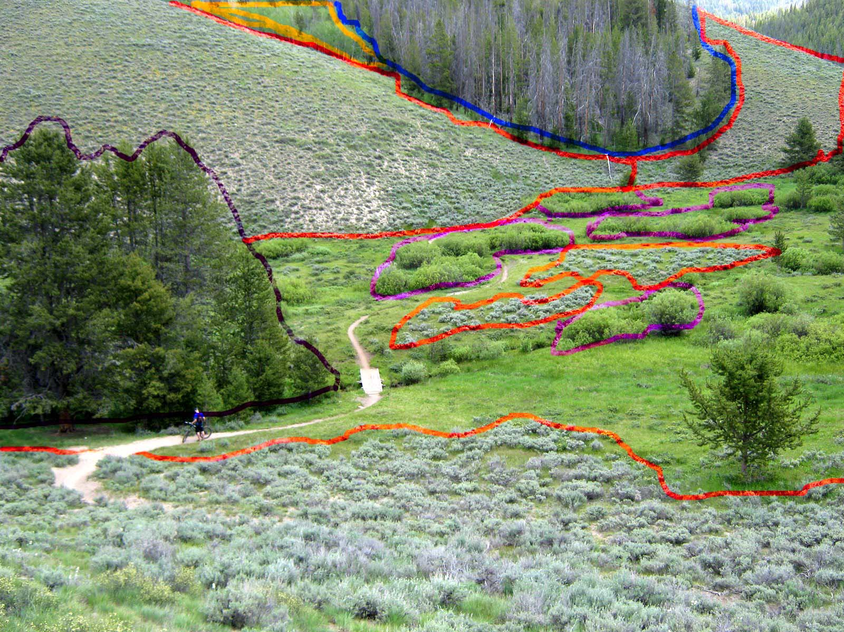
Fisher Creek trail, Idaho
Image used with permission from kanyonkris.blogspot.com
Notes:
Examples of differing soil, elevation, drainage create varied habitat from the creek upwards (sage grows were water drains quickly. Shrubs grow where water is plentiful in valley and grass grows where there is water and good soil. Lodgepole pine in top center grow only on the North facin slopes where there is less direct light and they can conserve water. Other pines on left grow in low, relatively wetter areas. Aspen (orange) grow on margins of pines with plenty of light and open space.

Slide 3
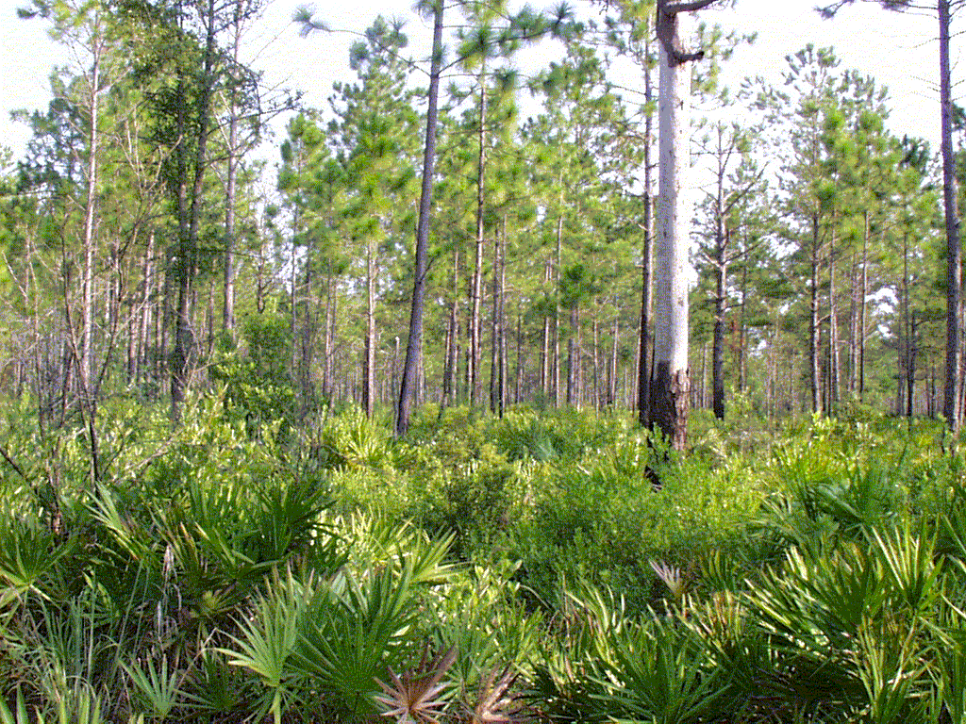
U. Of Florida, IFAS Extension Public Domain
Notes:
Florida pine forest shows vertical layering of habitat

Slide 4
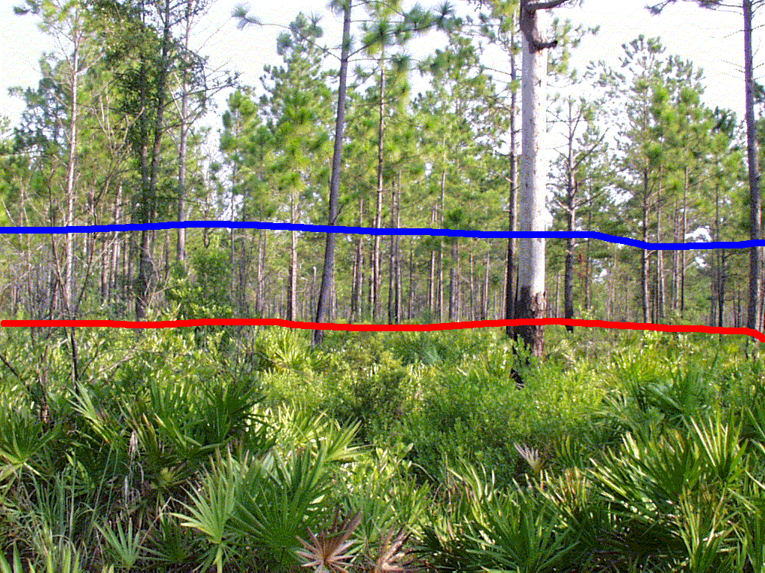
U. Of Florida, IFAS Extension Public Domain
Notes:
Lines represent understory (shrubs), middle (mostly open), and canopy (start of branches) and shows vertical organization of biotic factors. Controlled by light availability (abiotic)

Slide 5
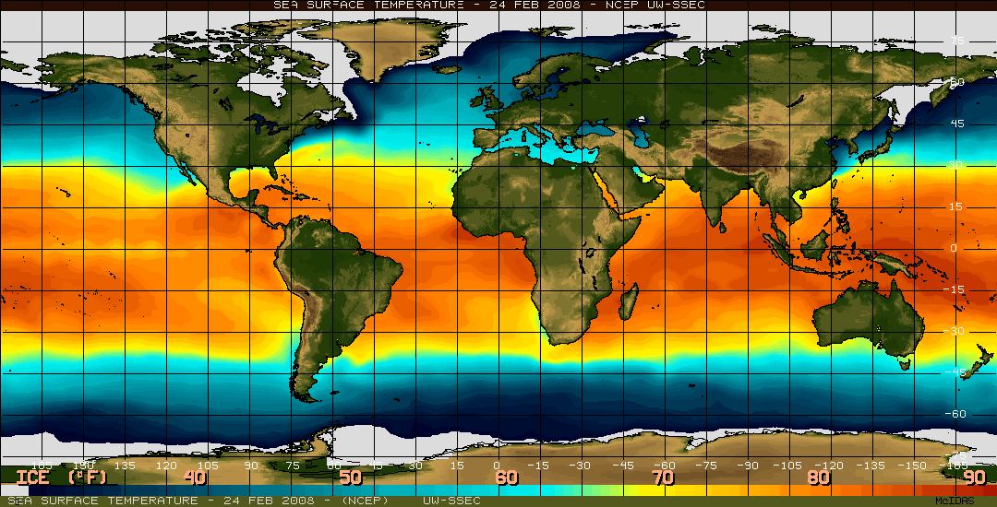
Image from data at Space Science and Engineering Center, University of Wisconsin, Madison.
rhttp://www.ssec.wisc.edu/data/sst/
Notes:
Estimated temperature @ ocean surface, along with satellite images of earth surface. Shows large scale patchiness and biotic/abiotic organization.

Slide 6
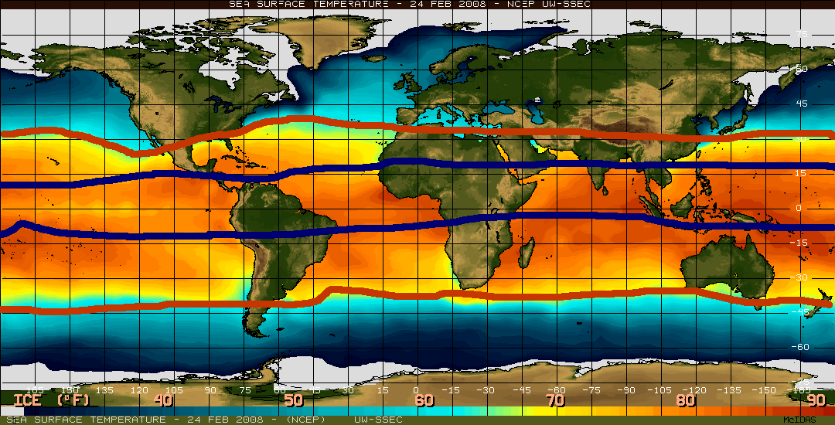
Image from data at Space Science and Engineering Center, University of Wisconsin, Madison.
rhttp://www.ssec.wisc.edu/data/sst/
Notes:
Lines indicate zonation of temperature from tropics to upper latitudes. Blue lines roughly outline the humid tropics. Vegetation follows ocean temperature.

Slide 7
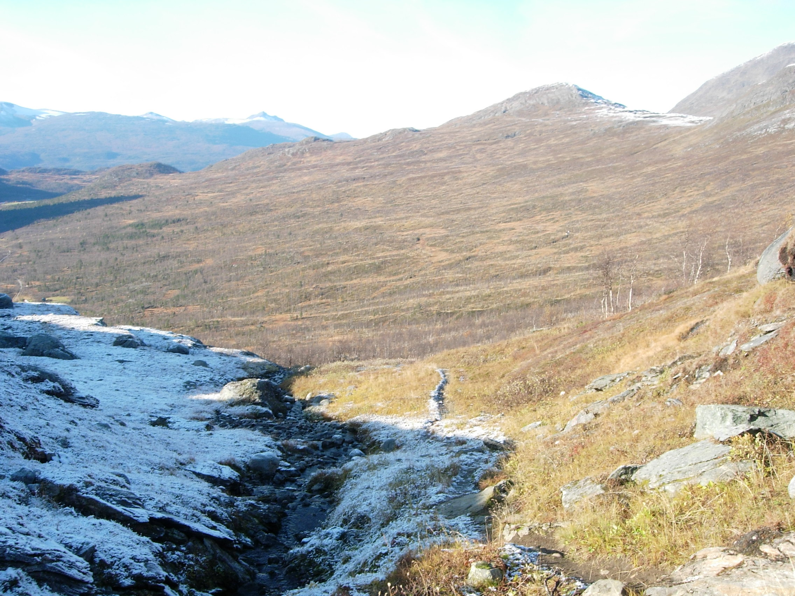
Image: Wikimedia Commons
Melting_snow.jpg. Public Domain
Notes:
Snow on unknown western landscape. Temporal and spatial patchiness. How long is the time frame for this patchiness?
Snow stays on north slope based on sun exposure and thus heat differences. This abiotic factor creates temporal patchiness in temperature (also an abiotic factor) and has effects on the flora and fauna that inhabit that side of the mountain. This is an example of an extremely short lived abiotic interaction. It is important to understand that time plays a role in abiotic/biotic interaction. Species that can move will prefer south slopes during cool weather to avoid this. This is especially true of ectotherms who must sun themselves and can get moving faster on slopes with good sun exposure.

Slide 8
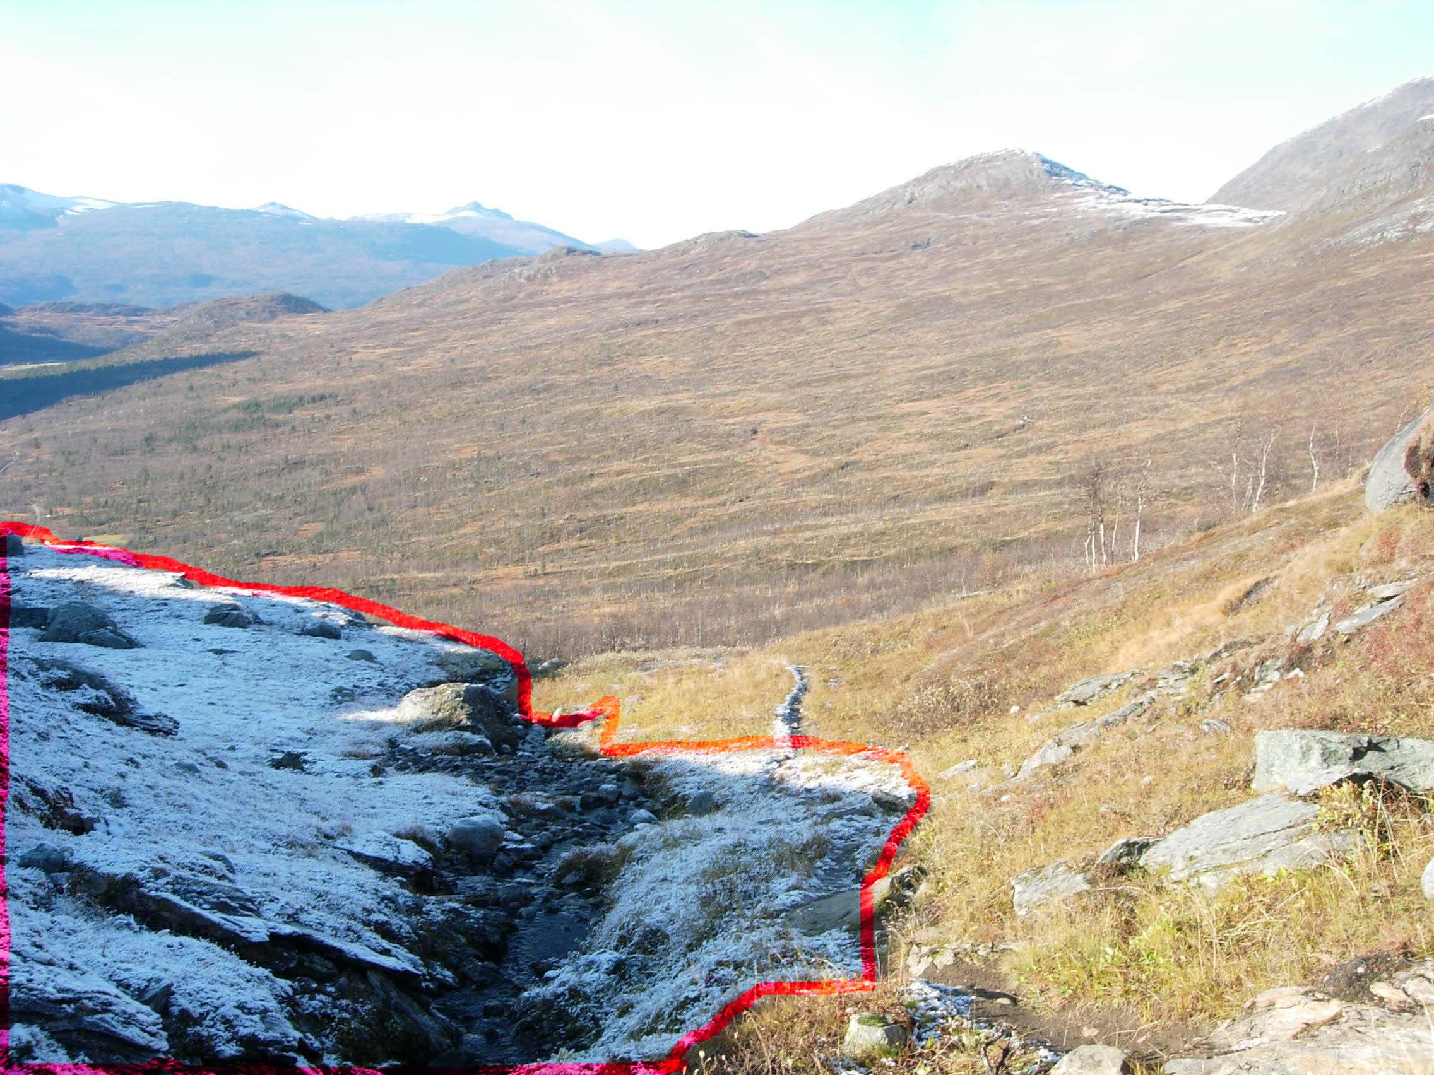
Image: Wikimedia Commons
Melting_snow.jpg. Public Domain
Notes:
Snow on unknown western landscape. Temporal and spatial patchiness. How long is the time frame for this patchiness?
Snow stays on north slope based on sun exposure and thus heat differences. This abiotic factor creates temporal patchiness in temperature (also an abiotic factor) and has effects on the flora and fauna that inhabit that side of the mountain. This is an example of an extremely short lived abiotic interaction. It is important to understand that time plays a role in abiotic/biotic interaction. Species that can move will prefer south slopes during cool weather to avoid this. This is especially true of ectotherms who must sun themselves and can get moving faster on slopes with good sun exposure.

