Slide 1
Optimal Foraging Lab
Fisheries 314
Sept. 11th, 2009

Slide 2
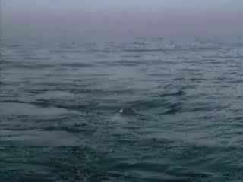

Slide 3
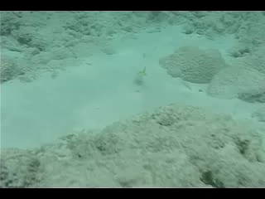

Slide 4
Multiple aspects of foraging
What general information can you glean about foraging from the behavior and habitat of the Yellow Goat Fish?
Food?
Environment?
Animal?
Notes:
Hints: Temporal spatial relationships

Slide 5
Optimal Foraging Theory
A suite of behavioral models attempting to predict the foraging strategy that should be favored by organisms under specific conditions

Slide 6
Assumptions
Present day foraging behavior is the behavior that has been favored by natural selection and most enhances fitness
High fitness is achieved by a high rate of energy intake

Slide 7
Assumptions
Experimental animals are observed in an environment to which their foraging is suited
Other factors (predators, competitors) which might influence behavior are of minor importance or do not impede the explanatory nature of the model

Slide 8
Are You an Optimal Forager?
Demonstration

Slide 9
The Marginal Value Theorem
A model predicting the time spent foraging in a patch before moving on to another patch. The optimal stay-time is defined in terms of the rate of energy extraction experienced by a forager at the moment it leaves a patch (i.e. the 'marginal value' of the patch).
Charnov (1976)
Notes:
Introduce the chart of Energy/Time now and ask for predictions of foraging for a patchy habitat

Slide 10
Assumptions of MVT
Patches exist with different resource densities.
Resource patches are randomly distributed.
Predators do not revisit patches.
An optimal forager will, on the whole, maximize its intake of a resource (usually energy) while foraging.
Notes:
Draw schematic of patchiness and show the line a predator might take through them.
Introduce Time/Energy graph and what I looks like as the animal moves through patches

Slide 11
Predictions
Within a given environment, all patches should be depleted to the same final extraction rate, the average rate for the environment as a whole. As a result, giving-up-time for a forager should be the same for all of those patches.
Notes:
Draw graph C on the board and explain

Slide 12
Predictions
Stay-times, number of resources consumed and foraging rates should be greater for more productive patches. Travel time is held constant.
Productivity can be defined by quantity.
Productivity can be defined by quality .
Productivity can be defined by foraging efficiency.
Notes:
Show how stay time for a rich patch is higher than for a thin patch on the graph

Slide 13
Predictions
Stay-times and number of resources consumed should be greater, while foraging rates should be lower in environments where the travel times are longer. Patch productivity is held constant.
Notes:
Draw graph D and explain why this would be

Slide 14
Predictions
For a given patch, stay-times and number of resources consumed should be greater, while foraging rates should be lower when the surrounding environment as a whole is less profitable.
Notes:
Draw graph E and explain

Slide 15
Testing the Marginal Value Theorem
Groups of 3-4
Develop experimental design to test one prediction of the Marginal Value Theorem
Write up a proposal and have it OK’d by me before leaving class today
Include all elements listed in your handout in your proposal

Slide 16
Independent Variables (treatments)
Energy value of resources
Amount of resources
Capture efficiency
Distance between patches
Productivity of environment

Slide 17
Dependent Variables (measurements)
Stay-time
Number of resources consumed
Foraging rate
Giving-Up-Time
Inter-Capture Interval (Time between finding each bean)

